Slide 1
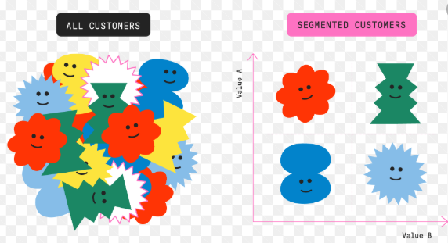
CUSTOMER SEGMENTATION

Slide 2
WHAT IS CUSTOMER SEGMENTATION?
TWO-FOLD PROCESS
Dividing customers into groups with similar interests
Determining which of this segments are viable targets.
Also called CONSUMER SEGMENTATION
Method of dividing specific market on the basis of demographics, behavioral, psychographic, benefits sought, geographical, etc.
By differentiating the customers, business can maximise profits from sales and generate high revenue.

Slide 3
COMMON TYPES OF CUSTOMER SEGMENTATION
DEMOGRAPHIC SEGMENTATION
Segment customers on the basis of demographic areas.
GEOGRAPHIC SEGMENTATION
Grouping customers on the basis of country, state, climate, region.
BEHAVIOURAL SEGMENTATION
Divide customers on the basis of how they interact with brand. Common variables include Occasion, Usage and Thought process.
LIFECYCLE OR CUSTOMER-JOURNEY BASED SEGMENTATION
Divides customer on the basis of which phase of buying they are.

Slide 4
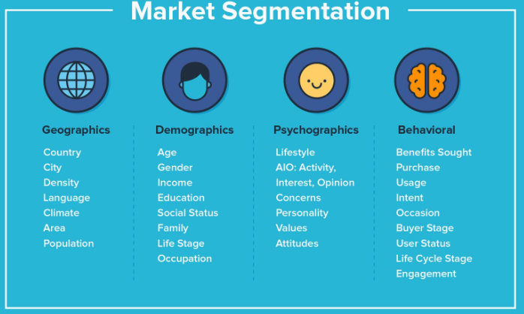

Slide 5
OBJECTIVES OF CUSTOMER SEGMENTATION
Increase marketing efficiency
Reduce risk in deciding the 5Ws of the business.
WHAT ARE THE 5Ws?
WHO are your customers?
WHERE do they live?
WHAT have customers done and what are they doing presently
WHEN are you likely to have customers.
WHY is the customer wants or needs what you have to offer.
“why” is pretty obvious, isn’t it? The customer wants or needs what you have to offer!

Slide 6
WHAT IS CRITERIA FOR SEGMENTING GROUPS?
It must be stable enough that it does not vanish after some amount of time.
It must be large enough to earn revenue.
It is useful in deciding on the market mix
It is internally homogenous
It is externally heterogenous
It responds consistently without any ups and downs.

Slide 7
Vital importance of segmentation
All markets and business have people with wide range of interests
It helps to define needs and interests more accurately.
The decision-makers can allocate resources more precisely
More precise resources -> greater evaluation of performance.

